Slide 1
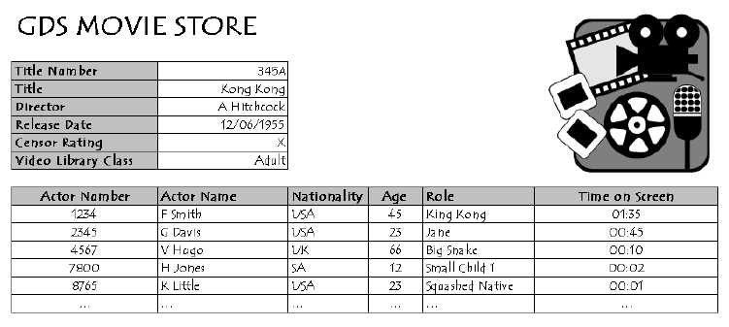
Conversion to 1st Normal Form (1NF) - Tutorial 3
Question
Using the data provided from the table below, normalise the data to the 1st Normal Form (1NF)

